Slide 1

Software requirements (swr302)
Tools for requirements engineering (chapter 30)

Slide 2
Requirements development tools
Elicitation tools
Mind-mapping: brainstorm & organize information
Converting text to auto-generated diagrams
Audio pens and other recording tools
Document scanning tools
Collaborative voting tools
Prototyping tools
Tools come with basic shapes and designs => wireframe
Mock up screens & the navigations between them or to annotate
Mocked-up functionality that a user can click through to see how the application would work. Some supports version control, feedback management, requirements linking, code generation
Modeling tools with standard shapes, notations, and syntax for drawing diagrams according to established conventions

Slide 3
Requirements management tools
Benefits of using an RM tool
Manage versions and changes
Store requirements attributes
Facilitate impact analysis
Identify missing and extraneous requirements
Track requirements status
Control access
Communicate with stakeholders
Reuse requirements
Track issue status
Generate tailored subsets

Slide 4
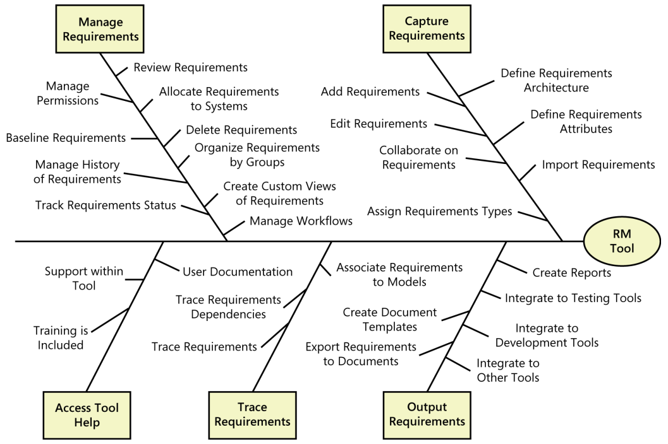
Requirements management tools
Requirement management tool capabilities

Slide 5
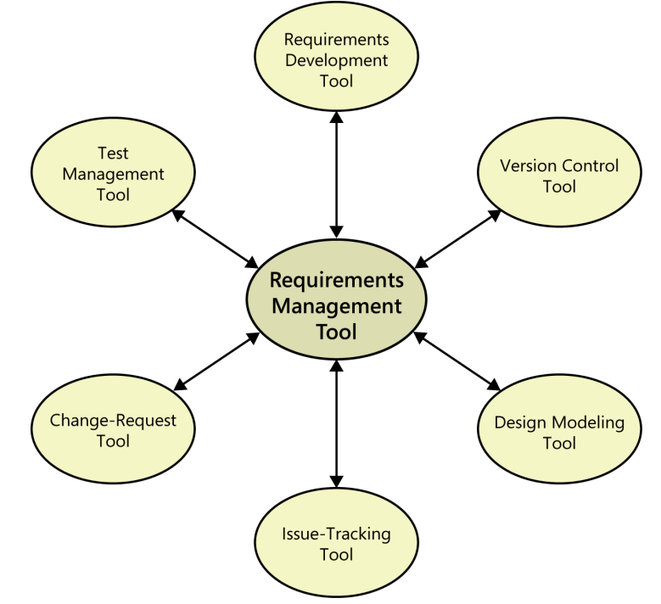
Requirements management tools
Requirement management tool capabilities

Slide 6
Selecting and implementing a requirements tool
Selecting a tool
Setting up the tool and processes
Facilitating user adoption

Slide 7


